Slide 1
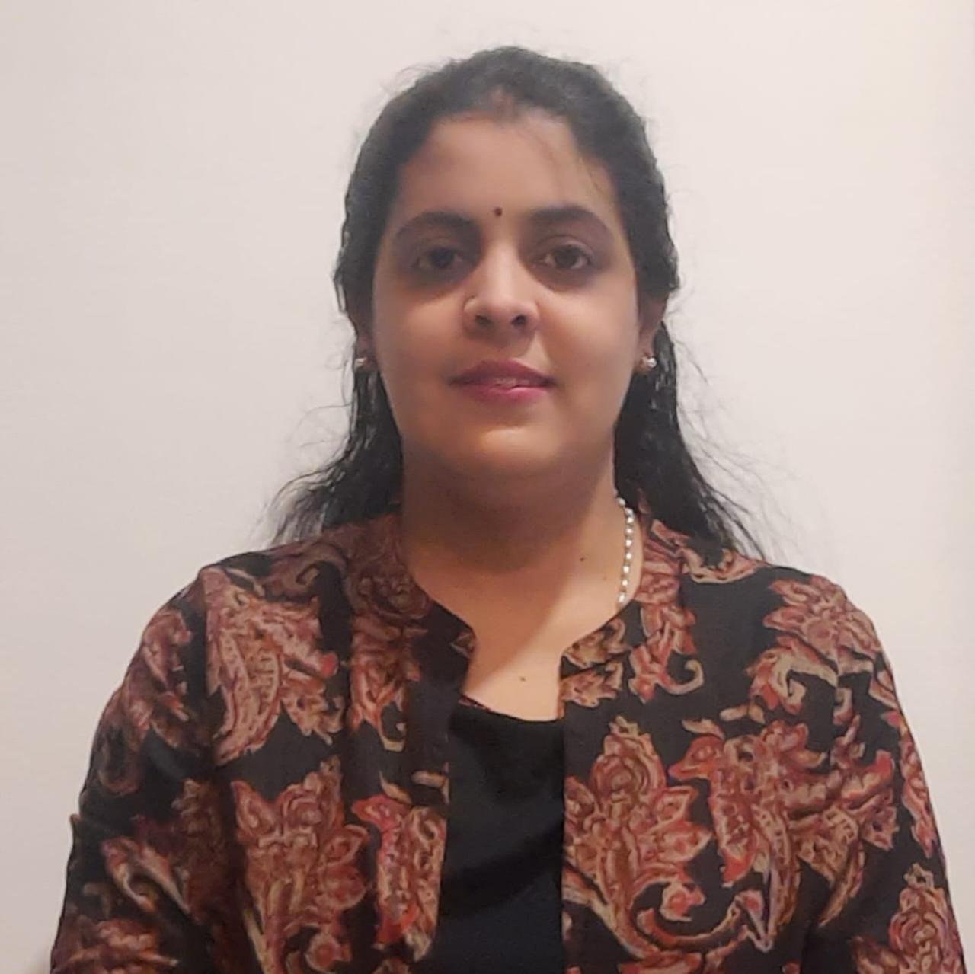
Overall 10+ years of experience working in different domains such as Educationist, Insurance Sector, HR, BPO.
10 months experience in AE working for FMCG ( Kellogg’s) Canada.
My day-to-day activity includes
Qualitative and Quantitative Analysis of Data.
Provide client support.
Building insights and responsible for end-to-end delivery of Analytics.
Project management Review and Resource allocation.
Personal Skills:
Communication
Presentation
Mentoring
Counseling
Deepashri K
Associate Consultant
Prior Experience
WNS Global Services
- Finance Analyst for AVIVA Insurance (UK)
Reliance Communications (BPO)-NRI Calling Cards
Higher Graduation
Diploma In NTT
Diploma in HR Management
B.Sc. In Statistics

